Slide 1

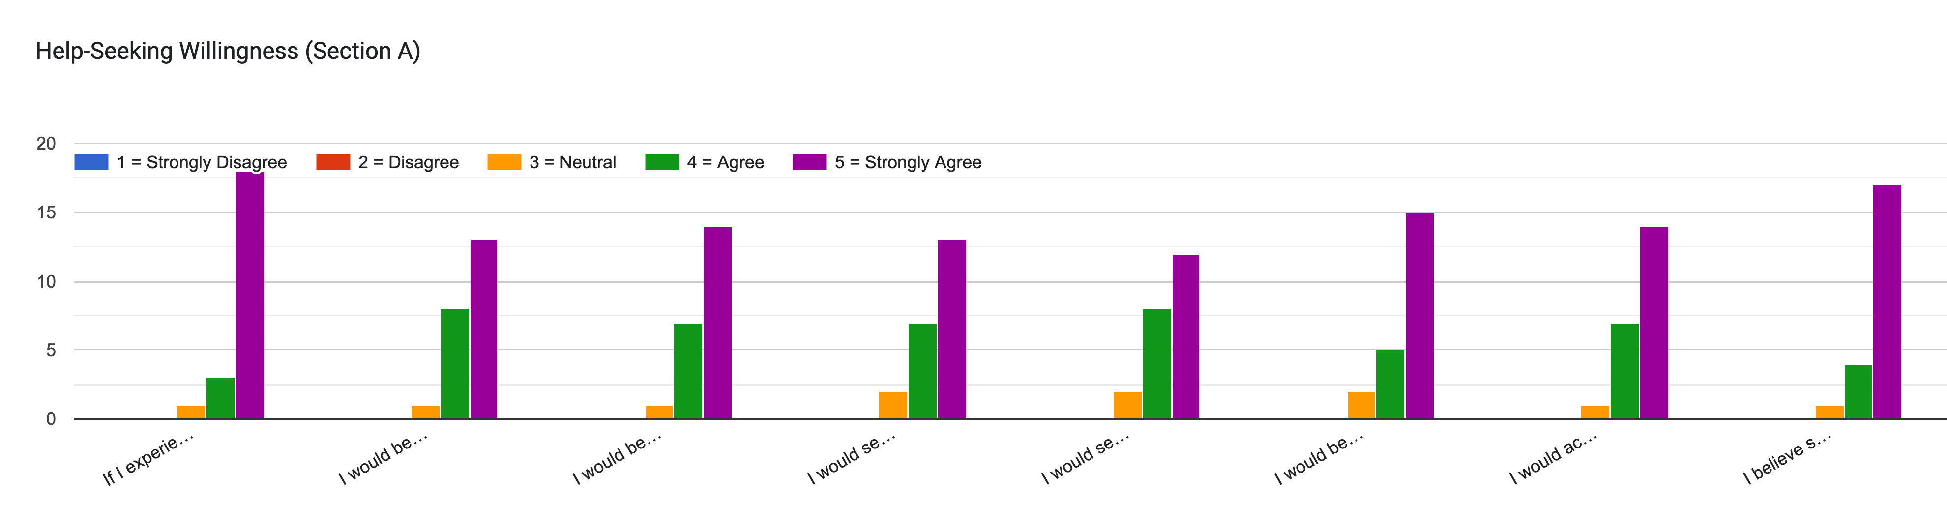
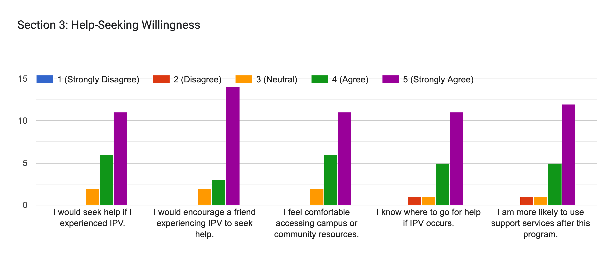
Improving Help Seeking Outcomes: The role of Intimate Partner Violence Education and Screening Programs in College Settings Kim Borel, Zanaib Kamara, Jasmine Morris,
Dr. Felisa Smith PhD, MSA, RN, CNE Nursing and Allied Health, Norfolk State University
BACKGROUND
RESULTS
Intimate Partner Violence (IPV) is a pervasive and often underrecognized public health issue affecting college students at alarming rates. IPV refers to any form of physical, sexual, emotional, psychological, or digital abuse within a romantic or intimate relationship. Among college-aged individuals (18–24), the risk of experiencing IPV is particularly high, with studies showing that up to one in three women and nearly one in two transgender or non-binary students report experiencing some form of relationship abuse during their academic careers (Centers for Disease Control and Prevention [CDC], 2017.
Fig 1.: Help seeking willingness (Pre- test)
Results demonstrated an increase in participants’ willingness to seek help despite embarrassment from 81.8% pre-intervention to 95.5% post-intervention, reflecting a 13.7% improvement. Post-intervention responses indicated consistently high levels of agreement across multiple domains, including intent to seek help, utilization of professional resources, acceptance of support, and belief in the effectiveness of interventions.
PURPOSE
This study examined whether a structured IPV education and screening intervention increased college students’ willingness to seek help and access campus or community support services within one academic semester.
CONCLUSIONS
Figure 2 Help seeking willingness (Post-test)
In conclusion, IPV education and screening programs may contribute to enhancing help-seeking behaviors among college students. Further research with larger sample sizes and matched data is recommended to evaluate the long-term effectiveness and sustainability of such interventions.
EXPERIMENTAL METHODOLOGY
A structured educational intervention on intimate partner violence (IPV) was conducted for undergraduate college students over one academic semester
.
The intervention included a 60-minute evidence-informed session incorporating didactic content, case-based discussion, role-play experiences, and information regarding campus and community support resources.
A quasi-experimental, one group pre-test/post-test design was utilized to evaluate changes in IPV knowledge, and attitudes toward help-seeking. Paired-samples t-tests was conducted to determine statistically significant differences between pre- and postintervention scores
Figures 1 and 2. A pretest-posttest design was utilized with a convenience sample of undergraduate students (N = 22). Participants completed a Likert-scale survey assessing knowledge, attitudes, and willingness to seek help both before and after the intervention. Due to the inability to match individual responses, data was analyzed at the group level using descriptive statistics, including means and percent change, to compare pre-intervention and post-intervention scores. The average mean score for all “help-seeking willingness” was 4.60. Respondents show a relatively high mean score for understanding barriers to seeking help with a mean average of 7.94. These findings suggest a modest positive effect of the intervention on students’ knowledge, attitudes, and willingness to seek help. Although the increase was small, it reflects a trend toward improved awareness and reduced barriers to accessing support services.
REFERENCES
Centers for Disease Control and Prevention. (2015). National intimate partner and sexual violence survey: 2015 data brief – updated release. Centers for Disease Control and Prevention. Retrieved February 11, 2026, from http://stacks.cdc.gov/view/cdc/60893
Centers for Disease Control and Prevention. (2017). https://stacks.cdc.gov › cdc › cdc_98137_DS1. Retrieved February 2, 2026, from The National Intimate Partner and Sexual Violence Survey
ACKNOWLEDGEMENTS
Dr. Felisa H. Smith, PhD, MSA, RN, CNE, NSU Nursing and Allied Health Department
Ms. Sandra Olanitori RN, Recruiter, NSU Nursing and Allied Health Department

